Slide 1
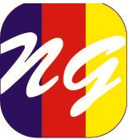
NAFISA GROUP
(Innovative Solution of Textile Industry) Since 2000

Slide 2
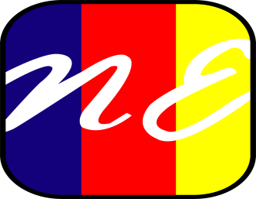
SISTER CONCERN
OF
NAFISA GROUP
NAFISA ENTERPRISE
NAFISA FOOD & BEVERAGE LTD.
COLOR MATCH
ECO EARTH BUILDERS
NATIONAL ENVIRONMENTAL CONTROLS (BD)

Slide 3
CHANNEL PARTNER

Slide 4
Executive Summary
Nafisa Enterprise is 100% local (Bangladeshi) owned company with dedication business on Textile Dyes- Chemicals. The company is a result of an initiative by one qualified and experienced person Mr. Harun-OR-Rashid who had a sales background from multinational company and engaged with the textile business in Bangladesh since 2000.
Nafisa Enterprise is a partner of several reputed global companies also providing sales and services on behalf of them in the textile market in Bangladesh. Currently Nafisa Enterprise is very successful doing business in Pre treatment (ETP & WTP), Dyeing & Finishing in textile, Textile machineries sales and services. Currently Nafisa Enterprise has decided to expand according to our market strength in Garments Dyeing & Fashion Segment too.

Slide 5
Our Services
Technical Support: We have own dyeing and testing laboratory which is used for the following purposes at International standard.
Color Matching
Sample Dyeing
Sample Development
Fastness Test
Rubbing Test
Spare parts of Textile Machineries

Slide 6
OUR STANDART

Slide 7
Research & Development
We believe in quality not only of the finished product, but also from the primary stage of production. That’s why we have an up-to-date laboratory with all kinds of modern equipments like sample dyeing m/c, spectrophotometer, crocking meter & other testing equipments for ensuring quality.

Slide 8
Executive Summary
As we (Nafisa Enterprise) are a very strong team in terms of technical solution & services in the market so our target is to get maximum market share within five years of time. And according to our strength & reputation we can do it.

Slide 9
Product Portfolio
Reactive, Disperse & Acid Dyestuff:
JIHUA GROUP—China
JIHUA has a excellent different series of dyestuff. These are very good & competitive in shade depth & Quality. Jihua group is a market leader in china for the manufacture of dyes and intermediates with state-of-the-art facilities. With the increasing regulatory focus on environmental compliance, Jihua group is a trusted partner who share our belief in sound environmental and ethical practices.
All Type of Chemicals:
OXFORD Technologies—Australia
Oxford Chemicals has a very good range of products on Textile Dyeing & Finishing Department. Also Garments Dyeing & Fashion segment.

Slide 10
Product Portfolio
All kinds of Textile dyestuff
All kinds of Textile Auxiliaries Chemical
ETP(Environment Treatment Plant)
Water Recycling & Re-use( Eco System –Singapore)
All Kinds of Textile Machineries

Slide 11
Thanks for your patience

